Slide 1
Week 4: Exhaustive Search, Recurrences, Graphs
Recurrences:
Recurrence for mergesort ([optional] Q4.2)
Solving some recurrences (Q4.1)
Exhaustive search:
Subset-sum problem (Problem Q4.3)
[time permitted] Partition problem (Problem Q4.4)
Graphs:
Representation ( Q4.5, Q4.6)
[time permitted] Sparse & dense graphs (Problem Q4.7)
Lab:
Questions with racecar last week?
Create linked list module & test it
Create minimal-effort stack module & test it
Events:
Mid-semester test in Week 5, worth 10%.
Assignment 1, due around Week 6, worth 10%.

Slide 2
Recurrences: mergesort (Q4.2)
Mergesort is a divide-and-conquer sorting algorithm made up of three steps (in the recursive case):
Sort the left half of the input (using mergesort)
Sort the right half of the input (using mergesort)
Merge the two halves together (using a merge operation)
The Task: Construct a recurrence relation to describe the runtime of mergesort sorting n elements. Explain where each term in the recurrence relation comes from.
Answer:

Slide 3
Recurrences: Q4.1 extended
Solve the following recurrence relations, assuming T (1) = 1.
T(n)=T(n−1)+4
T(n)=T(n−1)+n
T(n)=2T(n−1)+1
T(n)= 2T(n/2) + n
T(n)= T(n/2) + 1
Solving Recurrences using Substitution:
Use the recurrence, and substitute each appearance of n with something smaller, for instance, with n-1 (for a,b,c) or n/2 (for d,e)
Repeat a few substitutions until seeing a clear pattern
Use the pattern to get down to T(1)

Slide 4
4.1.b
Answer:
T(n) = T(n−1)+n
=
=
=
=
=
=
=
=

Slide 5
4.1.d
Answer:
T(n) = 2T(n/2) + n
=
=
=
=
=
=
=

Slide 6
4.1.a
Answer:
T(n) = T(n−1)+4
=
=
=
=
=
=
=
=

Slide 7
4.1.c
Answer:
T(n) = 2T(n−1)+1
=
=
=
=
=
=
=
=

Slide 8
4.1.e
Answer:
T(n) = T(n/2) + 1
=
=
=
=
=
=
=

Slide 9
exhaustive search = brute-force search = generate-and-test
Exhaustive search= go through all “potential solutions” until an answer is found (or until the end if not found at all).
Perhaps the most difficult part is to generate S = the set of all possible cases…
Examples:
Notes:
In many exhaustive search cases, recursive procedures are easier to build than iterative ones.

Slide 10
Question 4.3: subset-sum problem
Design an exhaustive-search algorithm to solve the following problem: Given a set S of n positive integers and a positive integer t, does there exist a subset S′ ⊆ S such that the sum of the elements in S′ equals t, i.e.,
If so, output the elements of this subset S′.
Assume that the set is provided as an array of length n. An example input may be S = {1,8,4,2,9} and t = 7, in which case the answer is Yes and the subset would be S′ = {1,4,2}.
What is the time complexity of your algorithm?

Slide 11
Q4.3: approaches = ???
// S: set of positive integers, t: an integer
// returns YES if there is a subset S’⊆ S
// such that the sum of elements in S’ equals t
// return NO if otherwise
function subset_sum(S, t)
Q: - What is a possible solution?
- What is the set of all possible solutions?

Slide 12
Q4.3: refining
function subset_sum(S, t)
for each S’ in Powerset(S) do
if (t = sum of elements in S’) then
return YES
return NO
// return the powerset of the set S
function Powerset(S)
if (S is ∅)return {∅}
??? need to call Powerset for a smaller set
???
Complexity analysis : Suppose that T(n) and P(n) are running time of the first and the 2nd alg.
P(n)=
T(n)=

Slide 13
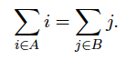
Q4.4 [optional, time permitted]: Partition problem
Design an exhaustive-search algorithm to solve the following problem:
Given a set S can we find a partition (i.e., two disjoint subsets A;B such that all elements are in either A or B) such that the sum of the elements in each set are equal, i.e.,
If so, which elements are in A and which are in B?
Again, assume S is given as an array. For example for S = [1, 8, 4, 2, 9] one valid solution is A = [1, 2, 9] and B = [8, 4].
Can we make use of the algorithm from Problem 3? What's the time complexity of this algorithm?
???

Slide 14
Graphs
Formal definition: G= (V, E)
concepts:
vertex (node), edge
graphs: dense, sparse, directed(di-graph), undirected, cyclic, acyclic, DAG, weighted, unweighted
Representation of graphs
adjacency matrix
adjacency lists
set V of vertices + set E of edges

Slide 15
Q4.5 a) For the graph, give: sets of vertices and edges, nodes that have highest degree , the representations as adjacency lists, adjacency matrices.
1: V={…} E={…}
2: ?
3: ?

Slide 16
Q4.5 a) For the graph, give: sets of vertices and edges, nodes that have highest degree , the representations as adjacency lists, adjacency matrices.
Adjacency lists Adjacency Matrix
A →
B →
C →
D →
E →
 | A | B | C | D | E
A
B
C
D
E

Slide 17
b) a directed graph:
Q4.5 b) For the graph, give: sets of vertices and edges, nodes that have highest degree (in- and out-degree), the representations as adjacency lists, adjacency matrices.
1: V={…}, E={…} 2: ? ?
A →
B →
C →
D →
E →
 | A | B | C | D | E
A
B
C
D
E

Slide 18
Notes for Graph Algorithms
If a graph acts as an input and/or an output of a graph algorithm, it’s normally specified as G=(V,E).
function Newgraph(G= (V,E))
// compute V’
// compute E’
G’ := (V’,E’)
return G’
That doesn’t imply the “sets of vertices and edges” graph representation
Often, we need to explicitly note the representation of the graph and use that to compute the complexity of the algorithm.
Or, we might need to specify the complexity for each of the 3 representations.

Slide 19
Question 4.6
Different graph representations are favourable for different applications. What is the time complexity of the following operations if we use (i) adjacency lists (ii) adjacency matrices or (iii) sets of vertices and edges?
determining whether the graph is complete
determining whether the graph has an isolated node
Assume that the graphs are undirected and contain no self-loop (edge from a node to itself). A complete graph is one in which there is an edge between every pair of nodes. An isolated node is a node which is not adjacent to any other node. Assume that the graph has n vertices and m edges.

Slide 20
Q4.6 a) determining whether the graph is complete
What is the time complexity of the above operations if we use: fill in your solution here!
Adjacency Lists | Adjacency Maxtrices | Set of Vertices & Edges

Slide 21
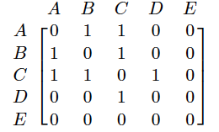
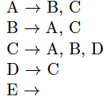
Q4.6 a) What if m= |E| is not available?
Sample graph for illustration:
Adjacency Lists | Adjacency Maxtrices | Set of Vertices & Edges
needed: if number of elements in each list is available: If not: | needed: | needed:

Slide 22
Q4.6 b) determining whether the graph has an isolated node: fill in
Would m help here?
Sample graph for illustration:
Adjacency Lists | Adjacency Maxtrices | Set of Vertices & Edges
needed: | needed: | needed:

Slide 23
Q4.7[time permitted]: Sparse and Dense Graphs
We consider a graph to be sparse if the number of edges, m ∈ Θ(n), dense if m ∈ Θ(n²).
Give examples of types of graphs which are sparse and types which are dense.
What is the space complexity (in terms of n) of a sparse graph if we store it using:
adjacency lists
adjacency matrix
sets of vertices and edges

Slide 24
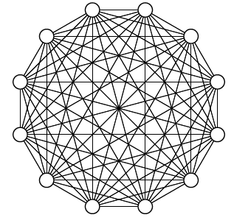
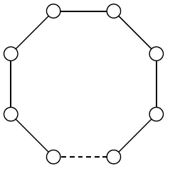
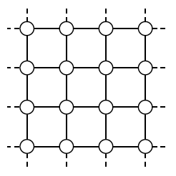
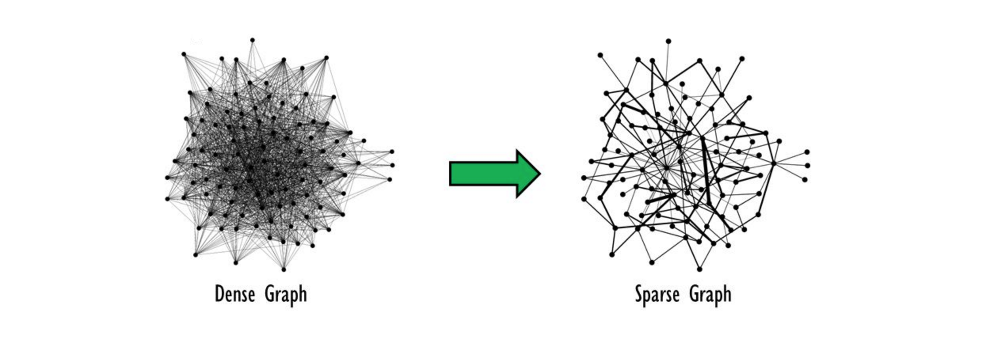
Sparse or Dense?

Slide 25
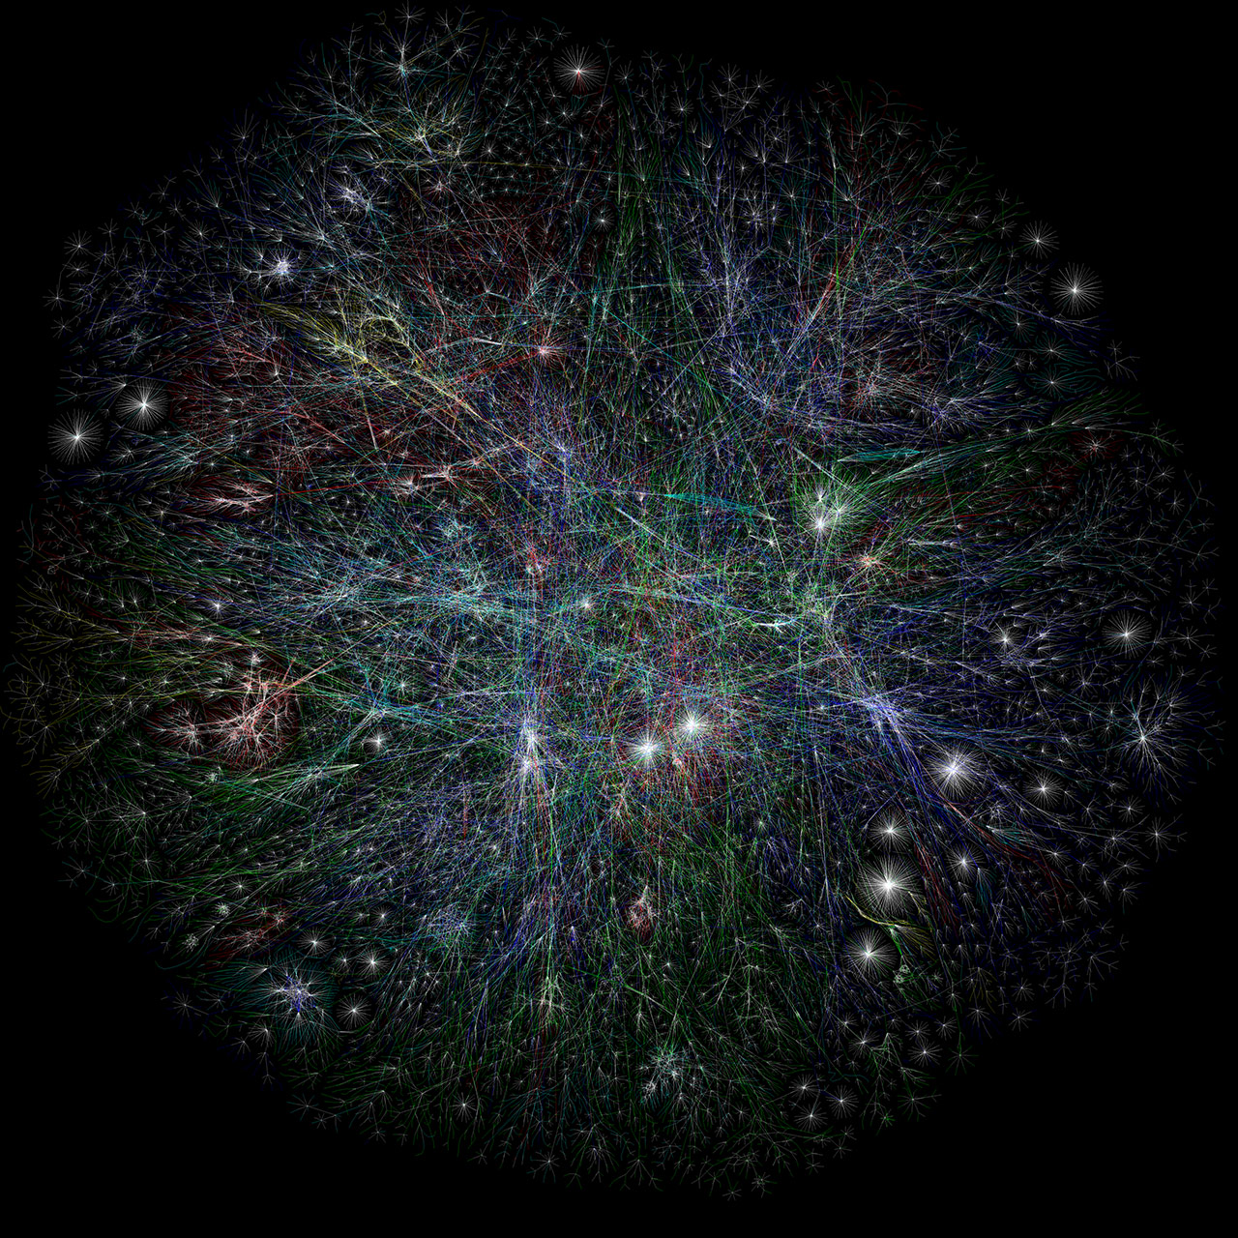
The Internet: Sparse or Dense?

Slide 26
Q4.7: [time permitted]: Sparse and Dense Graphs
We consider a graph to be sparse if the number of edges, m ∈ Θ(n), dense if m ∈ Θ(n²).
Give examples of types of graphs which are sparse and types which are dense.
What is the space complexity (in terms of n) of a sparse graph if we store it using:
adjacency lists :
adjacency matrix :
sets of vertices and edges :

Slide 27
Lab
Task 2:
Build module linked list with functions create_list, free_list, insert_at_front, insert_at_end, remove_at_front, remove_at_end.
Create test_list.c and Makefile with target list for testing linked list
Using the list module, and with least effort, build module stack
Create test_stack.c and add target stack for testing the stack module
Note: if needed, google “listops.c” and use it as a reference
MST:
Know time, procedure & how to start and submit
Coverage: probably lectures week 1-3 and workshops week 2-4
Review and give question now (or next week if applicable)
Assignment 1:
Understand the task before next workshop (Week 5)
Ask question during Week 5 workshop
Finish most of the work by Week 6 Workshop
Ask refinement questions during Week 6 workshop

